Slide 1
PASSPORTS
OF INVESTMENT SITES
IN ORSHA DISTRICT
NATIONAL AGENCY
OF INVESTMENT AND
PRIVATIZATION
REPUBLIC OF BELARUS
Vitebsk Regional
Executive Committee

Slide 2
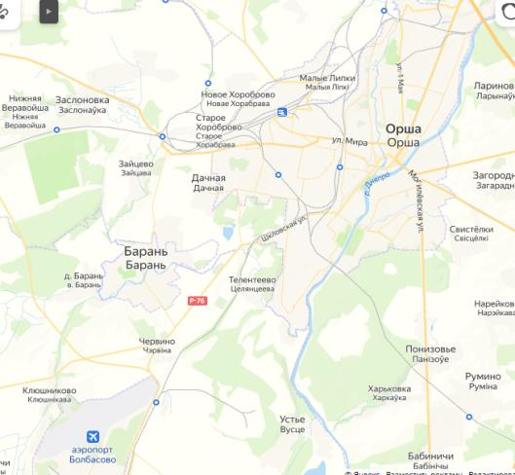
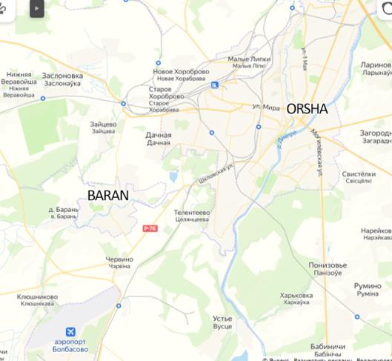
Plan of sites location
4
5
1) Orsha, near 39a Mira Street (FEZ “Vitebsk”) | 8.5 ha | p.3
2) Orsha, near JSC “Legmash” Plant (Orsha, 17 Vostochny Lane) (FEZ “Vitebsk”) | 2.5 ha | p.11
3) Property complex of the state enterprise “Orsha Regional Centre for Entrepreneurship and Real Estate Support” | 3.3 ha | p.19
4) Orsha, 238 Lenina Street | 4.0 ha | p.28
5) Orsha, 214 Lenina Street (FEZ “Vitebsk”) | 4.0 ha | p.36
6) Orsha, Pogranichnaya Street | 7.3 ha | p.44
6
1
2
3

Slide 3
Site No.1 Orsha, Pogranichnaya Street, 39a Mira Street

Slide 4
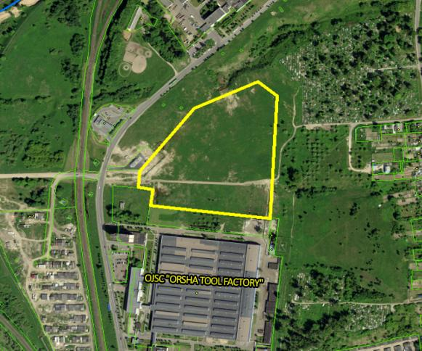
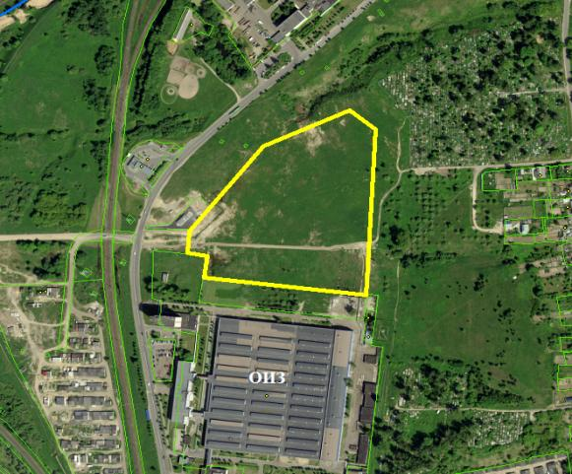
General information
Area: 8.5 ha
Land user: Orsha District Executive Committee
Asset holder: none
Type of ownership: state-owned
Land title documents in place: no.
Legal regime: territory of FEZ “Vitebsk”
Zoned as: urban land.
Real properties on site: none
Real properties title documents in place: no

Slide 5
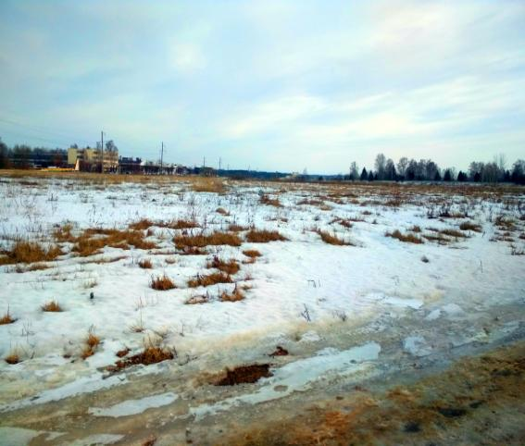
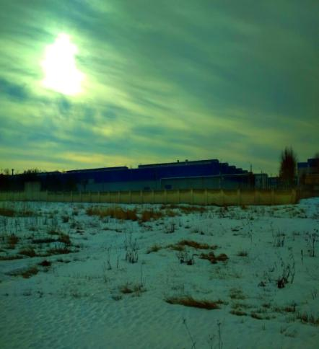
Actual condition and topography

Slide 6
Actual infrastructure
Utility lines
Transportation infrastructure
 | Distance to connection point | Type (well, centralised, drinking, non-potable)/Capacity | Year built | Depreciation | Condition/need for repair
Water supply | 1) 0.01 km to 150 mm gate valve | Centralised | 1973 | 100 % | satisfactory
 | 2) 0.10 km to 400 mm gate valve | Centralised | 2001 | 31 % | satisfactory
 | 3) 0.15 km to 250 mm gate valve | Centralised | 1972 | 80 % | satisfactory
Sewage system | 0.8 km to 400 mm gate valve | Centralised | 1977 | 100 % | satisfactory
Heat supply | ≈1.1km | D=530 mm | no possibility of connection to the heating network
Telecommunications (communication lines, fibre optics) | 2.5 km | FOCL | - | - | -
Gas supply | ≈0.5 km | 0.3 MPa, dia. 325 m, ≈2500 m³/hour | 1993 | 72.5 % | operational
Power supply | 3 km | 3 MW from sewing machines factory substation | 1986 | 100% | not required
 | 4 km | 5-10 MW from “Orsha-Severnaya” Substation | 1953 | 1000 % | not required
Motorways and highways | Distance to road | Type of surface | Year built | Depreciation | Condition/need for repair
 | 0.1 km | asphalt concrete | //- | //- | //-
Railroad | 0.2 | none | 0 | 0 | 0

Slide 7
Potential infrastructure
 | Required facilities and utilities | Distance | Possible capacity | Cost (approx.) (thousand BYN) | Distance to road | Possibility (source) of funding | Inclusion in programmes
Water supply | none | none | none | none | none | none | none
Sewage system | sewage networks | 0.8 km | 20.0 m³/hour | 150 | in accordance with the project | none | none
Gas supply | 0.3 MPa medium-pressure gas pipeline | ≈0.5 km | 0.3 MPa, dia. 325 m, ≈2500 m³/hour | 75 | on a contractual basis | none | none
Heat supply | no possibility of connection to the heating network | ≈1.1 km | none | - | - | none | none
Power supply | 10kV switchgear cubicle at sewing machines factory substation - 2 units, 10 kV cable line- 2 units, 10/0.4 kV transformer substation | 3 km | 3 MW | 2150 | in accordance with the project | none | none
 | Reconstruction of “Orsha-Severnaya” substation with replacement of 16 MVA and 25 MVA T-2 and T-3 power transformers with 40 MVA, installation of 10 kV switchgear cubicles at sewing machines factory substation - 2 units, 10 kV cable line - 2 units, 10/0.4 kV transformer substation (number to be determined by project) | 4 km | minimum capacity - 5MW, maximum capacity - 10MW | 6900 | in accordance with the project | none | none
Telecommunications | installation of a fibre-optic line | 2.5 km | FOC-2 | 16.5 | 6m | none | none
Motorways and highways | repair of the access road | 0.1 km | asphalt concrete | 23.7 | as per construction method statement | investor funding | none
Railroad | none | none | none | none | none | none | none

Slide 8
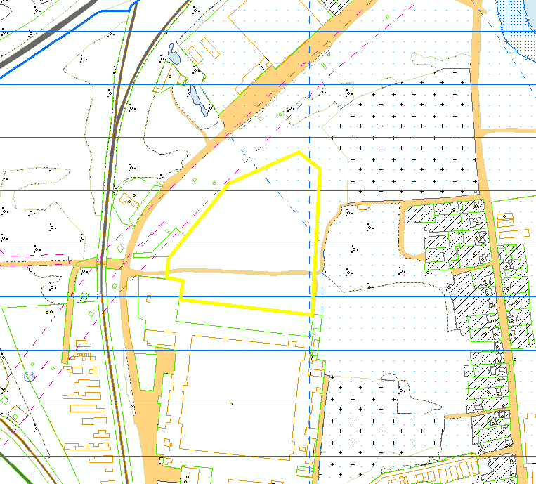
Restrictions
Protection zones: 35kV overhead line Orsha-Severnaya - rail welding plant (15 metres from outermost cable)
Encumbrances: 3rd zone of sanitary protection for water bodies used for household and drinking water supply; partially water protection zone of the Orshitsa River
Environmental restrictions: water protection zone of the Orshitsa River
Possible uses:
construction and maintenance of industrial facilities (sanitary protection zone of 50-100 m), petrol stations, service stations, warehousing and storage activities, administrative and ancillary services

Slide 9
Financial section: organisational expenses
Pos. | Criterion | Cost, thousand BYN | Source of funding
1 | Cost of land allocation | 10 | Investor funding
2 | Preparing an urban planning certificate in accordance with the project |  | local budget, with subsequent reimbursement of costs by investor
 | TOTAL organisational expenses: | 10 + estimated by the project

Slide 10
Financial section: Connecting to infrastructure
Pos. | Criterion | Cost, thousand BYN | Source of funding
1 | Gas supply | 75 | Investor funding
2 | Electrical grid
2.1 | Option 1 (3 MW) | 2150 | Investor funding
2.2 | Option 2 (5 MW) | 6900 | Investor funding
3 | Telecommunications | 16.5 | Investor funding
4 | Motorway | not required
5 | Sewage system | 150 | Investor funding
6 | Water supply | not required
 | TOTAL infrastructure costs: | Option 1: 2391.5 thousand BYN + estimated by the project Option 2: 7165.2 thousand BYN + estimated by the project
 | TOTAL overall costs: | Option 1: 2401.5 thousand BYN + estimated by the project Option 2: 7175.2 thousand BYN + estimated by the project

Slide 11
Site No.2 Orsha, 17 Vostochny Lane (near “Legmash” Plant )

Slide 12
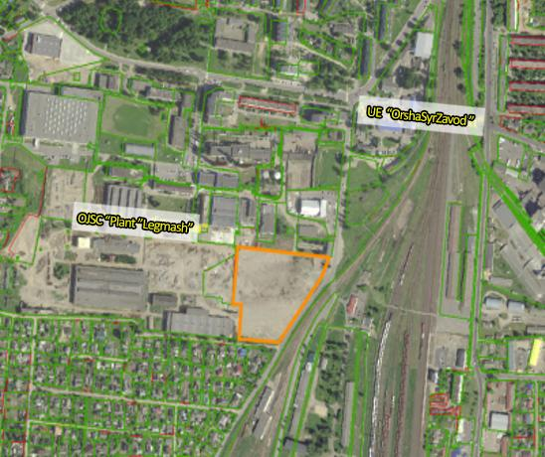
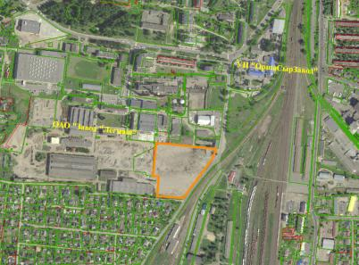
General information
Area: 2.5 ha
Land user: Orsha District Executive Committee
Asset holder: none
Type of ownership: state-owned
Land title documents in place: no.
Legal regime: territory of FEZ “Vitebsk”
Zoned as: urban land.
Real properties on site: none
Real properties title documents in place: no

Slide 13
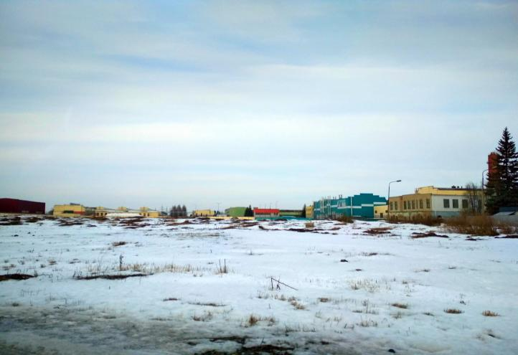
Actual condition and topography

Slide 14
Actual infrastructure
Utility lines
Transportation infrastructure
Water supply | Distance to connection point | Type (well, centralised, drinking, non-potable)/Capacity | Year built | Depreciation | Condition/need for repair
 | 1) 0.02 km to 100 mm gate valve | Centralised | 1972 | 80% | satisfactory
 | 2) 0.38 km to 300 mm gate valve | Centralised | 1965 | 100%
Sewage system | 1) 0.40 km to 500 mm gate valve | Centralised | 1972 | 100% | satisfactory
 | 2) 0.45 km to 300 mm gate valve | Centralised | 1976 | 100% | satisfactory
Telecommunications (communication lines, fibre optics) | 1.2 | FOCL | - | - | -
Gas supply | ≈0.35 km | 0.3 MPa, dia. 400 mm, ≈10000 m³/hour | 1986 | 90.00% | operational
Power supply | ≈0.7 km | 3 MW from sewing machines factory substation | 1986 | 100% | not required
Heat supply | ≈0.5 km | no possibility of connection to the heating network
 | Distance to road | Type of surface | Year built | Depreciation | Condition/need for repair
Motorways and highways | adjacent to the boundary | asphalt concrete | unknown | 90 | satisfactory
Railroad | 0.2 | none | unknown | - | satisfactory

Slide 15
Potential infrastructure
 | Required facilities and utilities | Distance | Possible capacity | Cost (approx.) (thousand BYN) | Distance to road | Possibility (source) of funding | Inclusion in programmes
Water supply | water mains | 0.38 km | 20.0 m³/hour | 70 | in accordance with the project | none | none
Sewage system | networks | 0.40 km | 5.0 m³/hour | 75 | in accordance with the project | none | none
 | sewage networks | 0.45 km | 10.0 m³/hour | 85 | in accordance with the project | none | none
Gas supply | 0.3 MPa medium-pressure gas pipeline | ≈0.35 km | 0.3 MPa, dia. 400 mm, ≈10000 m³/hour | 53 | on a contractual basis | none | none
Heat supply | no possibility of connection to the heating network | ≈0.5 km | none | - | - | none | none
Power supply | 10 kV switchgear cubicle at sewing machines factory substation - 2 units, 10 kV cable line - 2 units, 10/0.4 kV transformer substation | 0.7 km | 3 MW | 850 | in accordance with the project | none | none
Telecommunications | Installation of a fibre-optic line | 1.2 km | FOC-2 | 15.5 | 6 months | none | none
Motorways and highways | none | none | none | none | none | none | none
Railroad | none | none | none | none | none | none | none

Slide 16
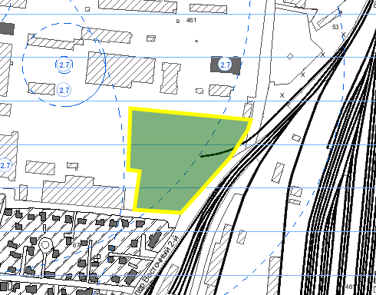
Restrictions
Sanitary protection zones: 50 – 100 metres
Encumbrances: 3rd zone of sanitary protection for water bodies used for household and drinking water supply
Environmental restrictions: none
Scheme of restrictions
Possible uses:
construction and maintenance of industrial facilities (sanitary protection zone of 50-100 m), petrol stations, service stations, warehousing and storage activities, administrative and ancillary services

Slide 17
Financial section: organisational expenses
Pos. | Criterion | Cost (thousand BYN) | Source of funding
1 | Cost of land allocation | 10 | Investor funding
2 | Preparing an urban planning certificate | in accordance with the project | local budget, with subsequent reimbursement of costs by investor
3 | Removal of vegetation with a need for compensatory planting | in accordance with the design and estimate documentation | investor funding
 | TOTAL organisational expenses: | 10 thousand BYN + estimated by the project

Slide 18
Financial section: Connecting to infrastructure
Pos. | Criterion | Cost, thousand BYN | Source of funding
1 | Gas supply | 53 | Investor funding
2 | Electrical grid | 850 | Investor funding
3 | Telecommunications | 15.5 | Investor funding
4 | Motorway | not required
5 | Sewage system | 160 | Investor funding
6 | Water supply | 70 | Investor funding
 | TOTAL infrastructure costs: | 1148.5 thousand BYN + estimated by the project
 | TOTAL overall costs: | 1158.5 thousand BYN + estimated by the project

Slide 19
Site No. 3 Orsha, 238 Lenina Street

Slide 20
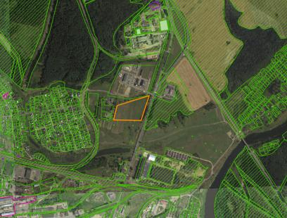
General information
Area: 4.0 ha
Land user: Orsha District Executive Committee
Asset holder: none.
Type of ownership: state-owned.
Land title documents in place: no.
Legal regime: none.
Zoned as: urban land.
Real properties on site: none
Real properties title documents in place: no

Slide 21
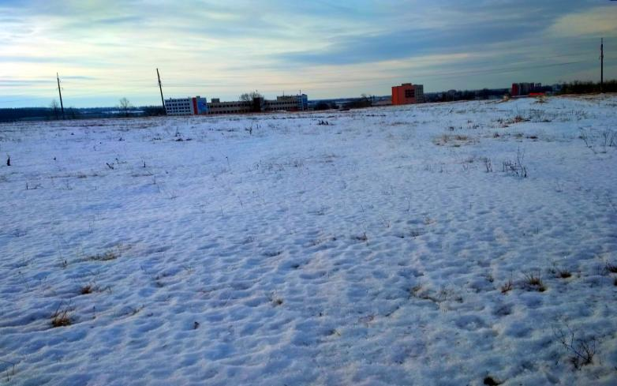
Actual condition and topography

Slide 22
Actual infrastructure
Utility lines
Transportation infrastructure
Water supply | Distance to connection point | Type (well, centralised, drinking, non-potable)/Capacity | Year built | Depreciation | Condition/need for repair
 | 0.05 km to 100 mm gate valve | Centralised | 1960 | 100% | satisfactory
Sewage system | 0 km to 200 mm gate valve | centralised | - | - | -
Telecommunications (communication lines, fibre optics) | 1.2 | FOCL | - | - | -
Heat supply | no connection available
Gas supply | ≈0.1 km | 0.3 MPa, dia. 219 mm, ≈3000 m³/hour | 1987 | 87.50% | operational
Power supply | 1.5 km | 0.5 MW from “Orsha-Severnaya” substation | 1953 | 100% | not required
 | Distance to road | Type of surface | Year built | Depreciation | Condition/need for repair
Motorways and highways | 30 m | asphalt concrete | unknown | 50 | satisfactory
Railroad | 1.5 | Orsha-Severnaya station | 0 | 0 | 0

Slide 23
Potential infrastructure
 | Required facilities and utilities | Distance |  | Possible capacity | Cost (approx.) (thousand BYN) | Distance to road | Possibility (source) of funding | Inclusion in programmes
Water supply | water mains | none |  | 5 m³/hour | 9.5 | none | none | none
Sewage system | none | 0.05 km |  | 5 m³/hour | none | in accordance with the project | none | 0.30 km
Gas supply | 0.3 MPa medium-pressure gas pipeline | ≈0.1 km |  | 0.3 MPa, dia. 219 mm, ≈3000 m³/hour | 16 | on a contractual basis | none | none
Heat supply | no possibility of connection to the heating network
Power supply | 10 kV switchgear cubicle at “Orsha-Severnaya” substation - 2 units, 10 kV cable line - 2 units, 10/0.4 kV transformer substation |  | 1.5 km | 0.5 MW | 1150 | in accordance with the project | none | none
Telecommunications | Installation of a fibre-optic communication line |  | 1.2 km | FOC-2 | 15.5 | 6 | none | none
Motorways and highways | none |  | none | none | none | none | none | none
Railroad | none |  | none | none | none | none | none | none

Slide 24
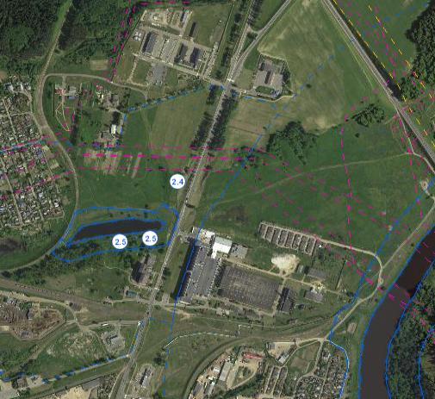
Restrictions
Sanitary protection zones: none
Encumbrances: in nature areas subject to special protection (in the water protection zone of the Dnieper River)
Environmental restrictions: water protection zone of the Dnieper River
Possible uses:
for the construction and maintenance of a commercial, administrative and ancillary services facility (facilities that do not have a sanitary protection zone (SPZ) or those with an estimated SPZ of less than 20 m)

Slide 25
Financial section: organisational expenses
Pos. | Criterion | Cost, thousand BYN | Source of funding
1 | Cost of land allocation | 10 | Investor funding
2 | Preparing an urban planning certificate | in accordance with the project | local budget, with subsequent reimbursement of costs by investor
 | TOTAL organisational expenses: | 10 thousand BYN + estimated by the project

Slide 26
Financial section: Connecting to infrastructure
Pos. | Criterion | Cost, thousand BYN | Source of funding
1 | Gas supply | 16 | Investor funding
2 | Electrical grid | 1,150 | Investor funding
3 | Telecommunications | 15.5 | Investor funding
4 | Motorway | not required
5 | Sewage system | not required
6 | Water supply | 9.5 | Investor funding
 | TOTAL infrastructure costs: | 1,191 thousand BYN
 | TOTAL overall costs: | 1,201 thousand BYN

Slide 27
Site No. 4 Orsha, 214 Lenina Street

Slide 28
General information
Area: 4.0 ha
Land user: Orsha District Executive Committee
Asset holder: none.
Type of ownership: state-owned.
Land title documents in place: no.
Legal regime: territory of FEZ “Vitebsk”
Zoned as: urban land.
Real properties on site: none
Real properties title documents in place: no

Slide 29
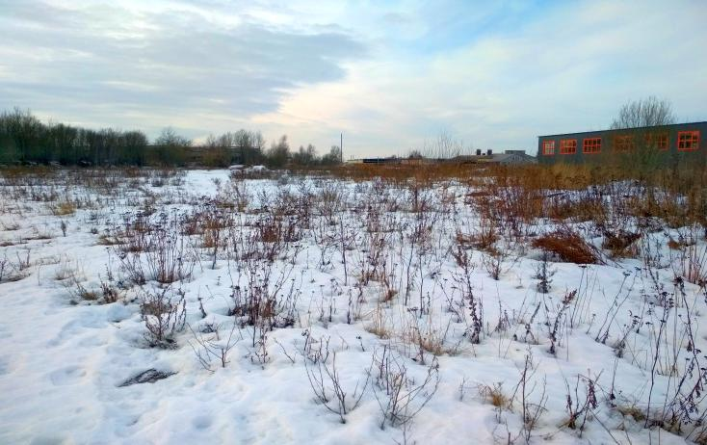
Actual condition and topography

Slide 30
Actual infrastructure
Utility lines
Transportation infrastructure
Water supply | Distance to connection point | Type (well, centralised, drinking, non-potable)/Capacity | Year built | Depreciation | Condition/need for repair
 | 0 km to 200 mm gate valve | Centralised | 1958 | 100% | satisfactory
Sewage system | 0.30 km to 400 mm gate valve | Centralised | 1990 | 100% | satisfactory
Telecommunications (communication lines, fibre optics) | 1 | FOCL | - | - | -
Heat supply | ≈0.3 km | D=426mm | 1986 | 100% | renovation required
Gas supply | ≈1.0km | 0.3 MPa, dia. 400 mm, ≈5000 m³/hour | 1977 | 100.00% | operational
Power supply | 1.4 km | 0.5 MW from “Orsha-Severnaya” substation | 1953 | 100% | not required
 | 1.4 km | 5-10 MW from “Orsha-Severnaya” substation | 1953 | 100% | not required
 | Distance to road | Type of surface | year built | Depreciation | Condition/need for repair
Motorways and highways | 0.5 km | asphalt concrete | unknown | 50 | satisfactory
Railroad | 1.3 | Orsha-Severnaya station | 0 | 0 | 0

Slide 31
Potential infrastructure
 | Required facilities and utilities | Distance | Possible capacity | Cost (approx.) (thousand BYN) | Distance to road | Possibility (source) of funding | Inclusion in programmes
Water supply | none | none | 15 m³/hour | none | none | none | none
Sewage system | sewage networks | 0.30 km | 15 m³/hour | 60 | in accordance with the project | none | none
Gas supply | 0.3 MPa medium-pressure gas pipeline | ≈1.9km | 0.3 MPa, dia. 400 mm, ≈5000 m³/hour | 160 | on a contractual basis | none | none
Heat supply | no possibility of connection to the heating network | ≈0.3 km | none | - | - | none | none
Power supply | 10 kV switchgear cubicle at “Orsha-Severnaya” substation - 2 units, 10 kV cable line - 2 units, 10/0.4 kV transformer substation | 1.4 km | 0.5 MW | 1100 | in accordance with the project | none | none
Telecommunications | Installation of a fibre-optic line | 1.0 km | FOC-2 | 15.5 | 6 | none | none
Motorways and highways | repair of the access road | 0.5 | asphalt concrete | 120 | as per construction method statement | none | none
Railroad | none | none | none | none | none | none | none

Slide 32
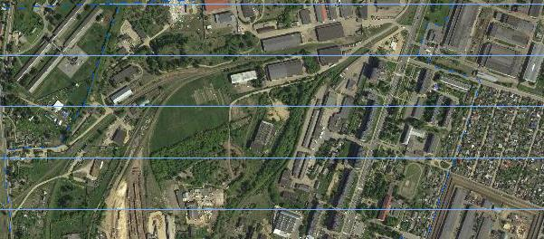
Restrictions
Sanitary protection zone: 50-100 metres
Encumbrances: 3rd zone of sanitary protection for artesian wells
Environmental restrictions: none.
Possible uses:
for construction and maintenance of an industrial facility (sanitary protection zone of 50-100 m), petrol station, service station, warehousing and storage activities, provision of administrative and ancillary services

Slide 33
Financial section: organisational expenses
Pos. | Criterion | Cost, thousand BYN | Source of funding
1 | Cost of land allocation | 10 | Investor funding
2 | Preparing an urban planning certificate | in accordance with the project | local budget, with subsequent reimbursement of costs by investor
 | TOTAL organisational expenses: | 10 thousand BYN + estimated by the project

Slide 34
Financial section: Connecting to infrastructure
Pos. | Criterion | Cost, thousand BYN | Source of funding
1 | Gas supply | 400 | Investor funding
2 | Electrical grid | 1,100 | Investor funding
3 | Telecommunications | 15.5 | Investor funding
4 | Motorway | 120 | Investor funding
5 | Sewage system | 60 | Investor funding
6 | Water supply | not required
 | TOTAL infrastructure costs: | 1,455.5 thousand BYN
 | TOTAL overall costs: | 1,465.5 thousand BYN

Slide 35
Site No. 5 Orsha, Pogranichnaya Street

Slide 36
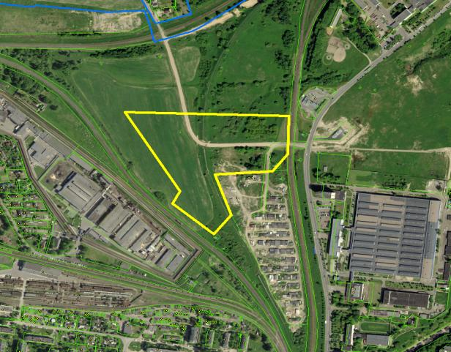
General information
Area: 7.3 ha
Land user: Orsha District Executive Committee
Asset holder: none.
Type of ownership: state-owned
Land title documents in place: no.
Legal regime: none.
Zoned as: urban land.
Real properties on site: none
Real properties title documents in place: no

Slide 37
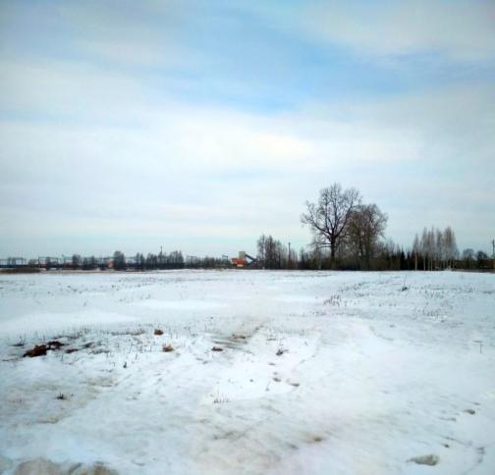
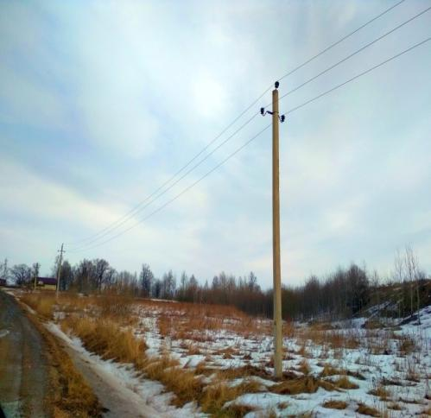
Actual condition and topography

Slide 38
Actual infrastructure
Utility lines
Transportation infrastructure
Water supply | Distance to connection point | Type (well, centralised, drinking, non-potable)/Capacity | Year built | Depreciation | Condition/need for repair
 | 0.30 km to 400 mm gate valve | Centralised | 2001 | 31% | satisfactory
Sewage system | 0.8 km to 400 mm gate valve | Centralised | 1977 | 100 | satisfactory
Telecommunications (communication lines, fibre optics) | 2.5 | FOCL | - | - | -
Heat supply | no possibility of connection to the heating network
Gas supply | ≈0.1 km | 0.3 MPa, dia. 300 mm, ≈2000 m³/hour | 1993 | 72.50% | operational
Power supply | 3.1 km | 2 MW from sewing machines factory substation | 1986 | 100% | not required
 | 4.2 km | 5-10 MW from “Orsha-Severnaya” substation | 1953 | 100% | not required
 | Distance to road | Type of surface | Year built | Depreciation | Condition/need for repair
Motorways and highways | 0.3 km | asphalt concrete | unknown | 90 | satisfactory
Railroad | 2.5 | Orsha-Vostochnaya station | 0 | 0 | 0

Slide 39
Potential infrastructure
 | Required facilities and utilities | Distance | Possible capacity |  | Cost (approx.) (thousand BYN) | Distance to road | Possibility (source) of funding | Inclusion in programmes
Water supply | water mains | 0.30 km | 20.0 m³/hour |  | 55 | in accordance with the project | none | none
Sewage system | sewage networks | 0.80 km | 20 m³/hour |  | 150 | in accordance with the project | none | none
Gas supply | 0.3 MPa high pressure gas pipeline | ≈0.1 km | 0.3 MPa, dia. 300 mm, ≈2000 m³/hour |  | 16 | on a contractual basis | none | none
Heat supply | no possibility of connection to the heating network
Power supply | 10kV switchgear cubicle at sewing machines factory substation - 2 units, 10kV cable line - 2 units, 10/0.4 kV transformer substation | 3.1 km |  | 2 MW | 2150 | in accordance with the project | none | none
 | Reconstruction of “Orsha-Severnaya” substation with replacement of 16 MVA and 25 MVA T-2 and T-3 power transformers with 40 MVA, installation of 10 kV switchgear cubicles at sewing machines factory substation - 2 units, 10 kV cable line - 2 units, 10/0.4 kV transformer substation (number to be determined by project) | 4.2 km |  | minimum capacity – 5 MW, maximum capacity – 10 MW | 7000 | in accordance with the project | none | none
Telecommunications | Installation of a fibre-optic line | 2.5 km |  | FOC-2 | 16.5 | 6 | none | none
Motorways and highways | repair of the access road | 0.3 |  | asphalt concrete | 71 | as per construction method statement | none | none
Railroad | none | none |  | none | none | none | none | none

Slide 40
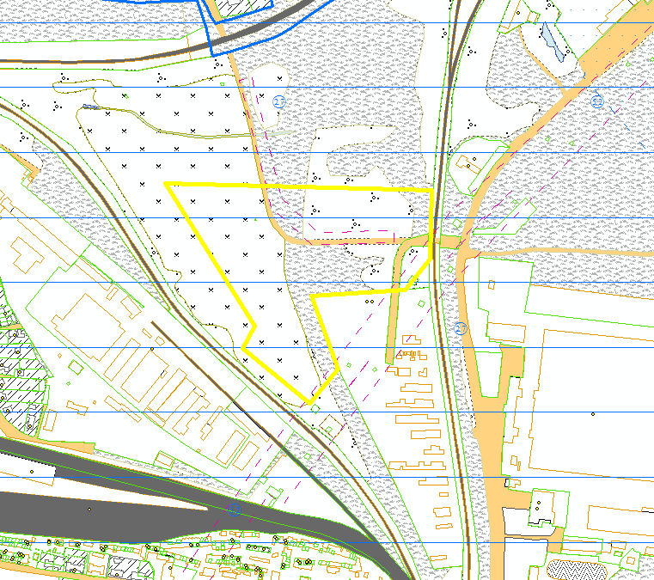
Restrictions
Sanitary protection zone: 50-100 metres
Encumbrances: in natural areas subject to special protection (in the zone of sanitary protection of a water body used for household and drinking water supply, in the zone of sanitary protection in water intake areas)
in the electrical grid exclusion zones
Environmental restrictions: none.
Possible uses:
for the construction and maintenance of a commercial, administrative and ancillary services facility

Slide 41
Financial section: organisational expenses
Pos. | Criterion | Cost, thousand BYN | Source of funding
1 | Cost of land allocation | 10 | Investor funding
2 | Preparing an urban planning certificate | in accordance with the project | local budget, with subsequent reimbursement of costs by investor
 | TOTAL organisational expenses: | 10 thousand BYN + estimated by the project

Slide 42
Financial section: Connecting to infrastructure
Pos. | Criterion | Cost, thousand BYN | Source of funding
1 | Gas supply | 400 | Investor funding
2 | Electrical grid
2.1 | Option 1 (2 MW) | 2,150 | Investor funding
2.2 | Option 2 (5 MW) | 7,000 | Investor funding
3 | Telecommunications | 16.5 | Investor funding
4 | Motorway | 71
5 | Sewage system | 150 | Investor funding
6 | Water supply | 55
 | TOTAL infrastructure costs: | Option 1: 2,842.5 thousand BYN + estimated by the project Option 2: 7,165.2 thousand BYN + estimated by the project
 | TOTAL overall costs: | Option 1: 2,468.5 thousand BYN + estimated by the project Option 2: 7,692.5 thousand BYN + estimated by the project

